Slide 1

Project Proposal
CSE - 465 Pattern Recognition & Neural Networking
Ultimate PowerPoint Template

Slide 2


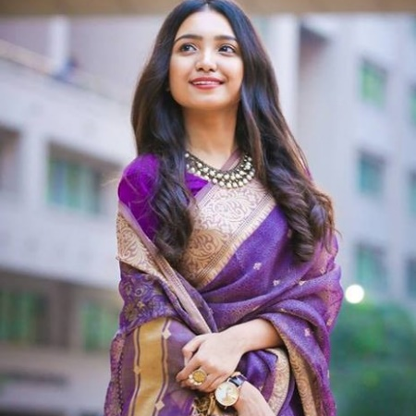

PROJECT TEAM
EKRAM UL KARIM
SHAMIM RAHMAN
BARSHA DAS TULI
TALBIA KABIR
1430643042
1430644042
1521164042
1521165042

Slide 3

PROBLEM DESCRIPTION
As a part of the assigned work for this course, we are requiring you to complete a project of your own choosing that is based on:
Convolutional Neural Networks (CNNs)
“Automatic Character Identification System”

Slide 4
DESCRIPTION
This work aims to realize a recognition system for a software engine that will automatically detect character using
Convolutional Neural Networks (CNNs) from a video content. Our system actually includes tracking a certain character from any content like TV show, cinema, or any other source and to count how many times the character is in frames. The main part of our work is to detect and identify faces/character from any series movies. Identification of characters in films, although very intuitive to humans, still poses a significant challenge to computer methods. Now a day’s character Identification from films is a very challenging task due to the huge variation in the appearance of each & every character. It will lead significant research interests and may have many interesting applications in today’s life. It is a challenging problem due to the huge variation in the appearance of each character. In particular, character identification for movie used video and script. Face tracking and clustering from video and name of person extract from script. Many challenges for face clustering and face-name matching are present. In good situation and clean environment existing methods gives better result, but in a complex movie scene performance is limited because face tracking and clustering process generate a noise. This task is challenging since characters present significant variation in their appearance.

Slide 5
WHY INTERESTING??
It would be helpful for the future generation to recognize the flower species that are unknown to them
It would be helpful for the human beings to realize the existence of unidentified flower species
It would be helpful for the human beings to characterize the medicinal plant species from different general flower species
It would be helpful for us to get ourselves acquainted with the concepts of feature extraction or combining shape, transfer learning, and CNNs which will eventually improve our skills to pursue a productive research
It would helpful for the flower plant sellers, flower gardeners to be familiar with the new species of flowers

Slide 6
FUTURE WORK
The proposed work is a faster way to train a Convolutional Neural Network (CNN) with a smaller dataset and limited computational resource such as CPU. As there are millions of flower species around the world, this system could easily be adapted by training more number of flower species images to recognize different species around the world. Thus, the future work would be to construct a larger database with not only flower images, but also with leaves, fruits, bark etc., collected from different sources around different parts of the world. This system would also be useful to identify plants for medicinal purposes such as in case of first aid. The user can quickly take an image of the plant species and get information about it to decide whether or not it can be used for first aid. The crucial part in building such a system is the training dataset which needs to be prepared either by manually taking pictures of the plants around the city or by using public datasets.

Slide 7

THANK YOU.
Grab a Coffee.
Subtitle Example

